Slide 1


How to query SNOMED CT encoded cancer pathology data sets (or synoptic reports)
Scott Campbell, PhD, MBA
An implementation overview of the Cancer Synoptic Reporting Working Group
Global terminology enabling quality information exchange

Slide 2
Summary of cancer pathology reporting project
Content covered today briefly discusses structured pathology reporting.
Tomorrow’s session is an in depth discussion of the Cancer Synoptic Reporting Working Group final product, electronic cancer pathology reporting, implementation and use
General discussion on how to interrogate SNOMED CT encoded cancer pathology data sets
Take aways:
-Synoptic structure of pathology reporting
-Data architectures suitable for synoptic data storage
-Query use cases using ECL

Slide 3

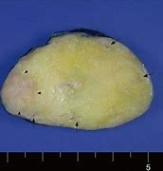
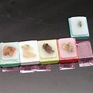

The Histopathology Process
Surgery
Gross Exam
Tissue Blocks
Histopathology Slide
Surgery performed to excise suspected lesions and/or remove tumor
Tissue macroscopically examined, described, measured
Tissue regions fixed in formalin and embedded in paraffin
Tissue blocks cut, tissue placed on glass slide, and stained

Slide 4
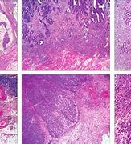
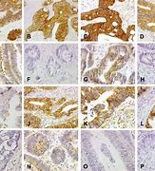
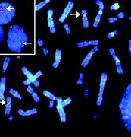
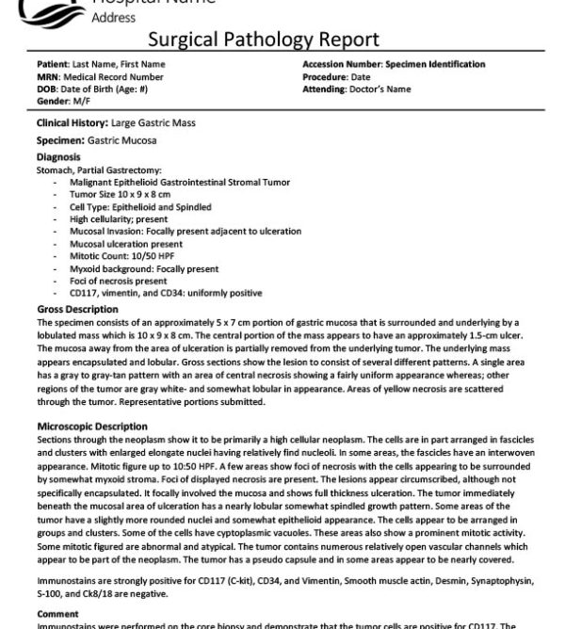
Microscopic Exam
Hematoxylin and Eosin
Immuno-histochemistry
Cytogenetic and molecular genomics
Report
H&E tissue examination to identify irregular tissue architecture
IHC stains help differentiate between underlying pathologies
Various genomic techniques used if needed
Final report issued

Slide 5
Information Model
Gross
[*..1]
[1..1]
Final Report
Case
[1..*]
Part
[1..*]
Microscopic
[*..1]
[0..*]
[*..1]
Special study

Slide 6
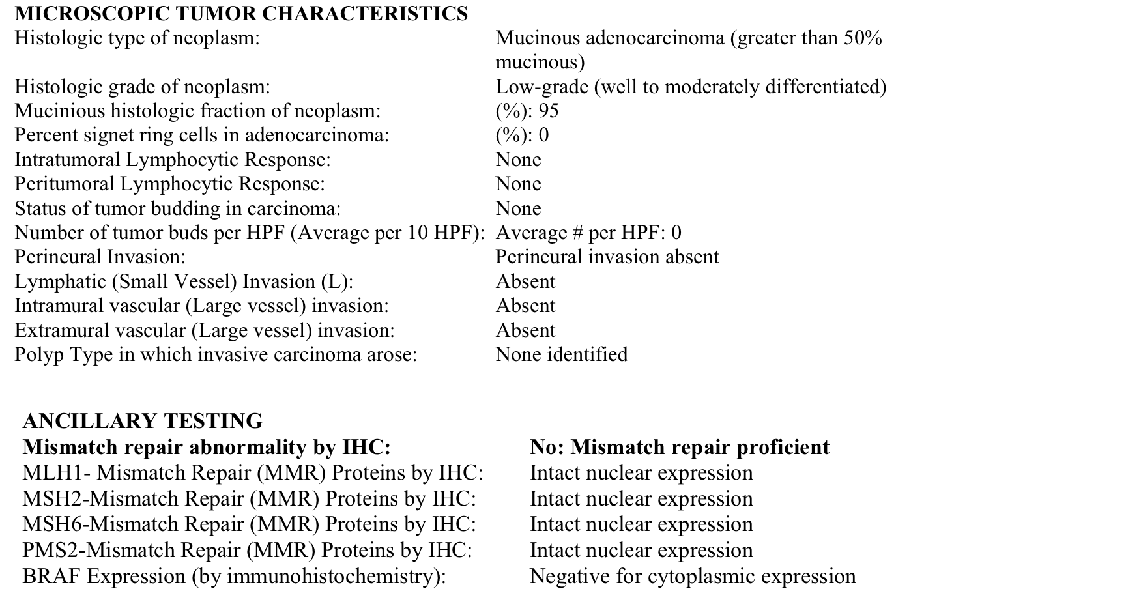
Final Report Using Synoptic Style

Slide 7
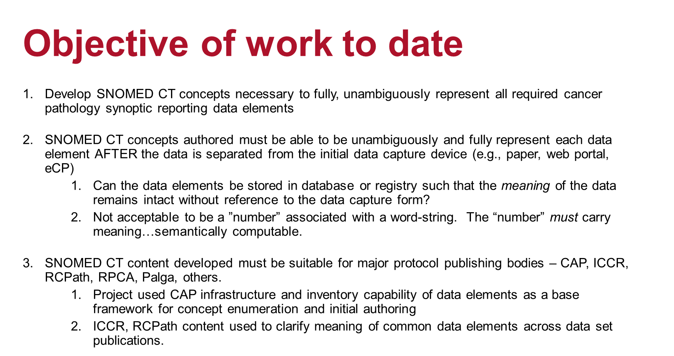
Objective of CSRWG
Develop SNOMED CT concepts necessary to fully, unambiguously represent all required cancer pathology synoptic reporting data elements
SNOMED CT concepts authored must be able to be unambiguously and fully represent each data element AFTER the data is separated from the initial data capture device (e.g., paper, web portal, eCP)
Can the data elements be stored in database or registry such that the meaning of the data remains intact without reference to the data capture form?
Not acceptable to be a ”number” associated with a word-string. The “number” must carry meaning…semantically computable.
SNOMED CT content developed must be suitable for major protocol publishing bodies – CAP, ICCR, RCPath, RPCA, Palga, others.
Project used CAP infrastructure and inventory capability of data elements as a base framework for concept enumeration and initial authoring
ICCR, RCPath content used to clarify meaning of common data elements across data set publications.

Slide 8
Project Status
> 1000 new concepts created and/or fully modeled
100% of CAP required data elements for all solid tumors
61 data sets
Includes both adult and pediatric data sets
CAP PERT committee reviewing and approving SNOMED CT terminology binding and association with C-keys.
CAP to include SNOMED CT terminology bindings in eCP and other release formats
24 ICCR data sets initially mapped to SNOMED CT
Terminology binding on-going for remaining data sets
Terminology binding to be reviewed and validated for use by ICCR

Slide 9
Synoptic structure
Structured pathology cancer reporting is built as a series of questions and answers that summarize the key, actionable features of the cancer for patient care
The ”Questions” are features of the tumor that the pathologist is to observe, measure or describe
The “Answers” represent what the pathologist observed.
In the pathology cancer report protocols, each question or tumor feature to be assessed is paired with a constrained set of acceptable answers or “measurements”
Pathology societies and other domain authorities define what features of tumors should be assessed and how those assessments should be made

Slide 10
Content developed
Procedure used to collect the specimen(s)
Tumor site
Tumor dimensions
Histologic type
Histologic grade
Anatomic location(s) involved by direct, contiguous extension of the neoplasm
Tissue layers
Adjacent tissue structures
Lymph/vascular invasion
Perineural invasion
Presence of neoplasm at surgical margins
Lymph node metastasis
Number lymph nodes involved by metastasis
Number lymph nodes examined
Location of lymph nodes
Anatomic locations involved by metastatic, discontinuous spread of the neoplasm
TNM staging (Tumor, Node, Metastasis)

Slide 11
Design Assumptions and Approach
Observable entity hierarchy used
Question carries the context to unambiguously interpret the observation
Explicit pathology knowledge NOT carried by SNOMED CT
Pathologist carries and expresses their knowledge when recording their observation
Part | Type |  | Description
Question | CODED_TEXT | << |Observable entity (observable entity)| | The question
Observation | CODED_TEXT | << 123037004 |Body structure (body structure)| OR ??? | The coded result of the observation
Interpretation | Implied - Context dependent | N/A | The interpretation of the observation based on agreed guidelines/rules

Slide 12
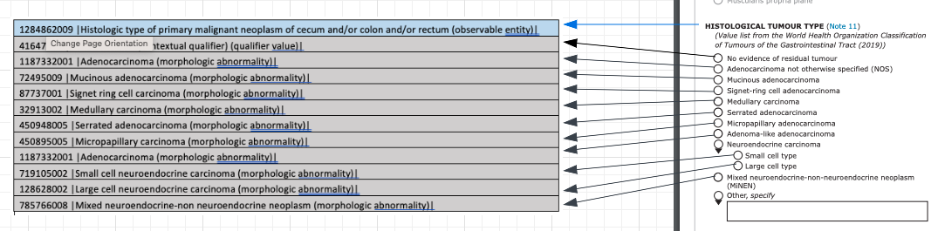
Example – Colon Histology
SNOMED CT Bindings
ICCR Data Elements
X
1284862009 |Histologic type of primary malignant neoplasm of cecum and/or colon and/or rectum (observable entity)|
= 450948005 |Serrated adenocarcinoma (morphologic abnormality)|
Similar terminology bindings are complete and ready for ICCR review for 24 data sets

Slide 13
Observable entity defining attributes
Attribute | Description
|Property| | This attribute is used to assert the property, or feature, being assessed by the pathologist. Target values for this attribute include: <<410668003 |Length property (qualifier value)|; <<30001000004102 |Histologic feature (property) (qualifier value)|; <1300001000004107 |Location property (qualifier value)|; 705057003 |Presence (property) (qualifier value)|; 118582008 |Percent (property) (qualifier value)|; 758637006 |Anatomic location (property) (qualifier value)|
|Inheres in| | This attribute is used to assert the entity that carries the property being measured. In most cases, the target values are <<108369006 |Neoplasm (morphologic abnormality)|
|Inherent location| | The inherent location attribute is used to describe the anatomical location of the entity that carries the property being assessed. In most cases, the inherent location indicates the anatomical location of the primary malignant neoplasm, that is the primary organ affected by the malignancy.
|Component| | This attribute is used to indicate an entity that is being assessed for presence such as necrosis within a neoplasm. It is also used to represent the numerator in an percent observation.
|Relative to| | This attributed is used for the denominator in a percent or number fraction observable.
|Direct site| | Direct site is specifically used to define the specimen in which the observation is being made.
|Technique| | Technique is used to define the method by which the observation is being made. This attribute is used to specific methods of tumor staging, histologic grading methods, direct vision (gross) evaluation, microscopy and immunohistochemistry methods.
|Time aspect| | The time aspect for all cancer pathology observable entities is 123029007 |Single point in time (qualifier value)|.
|Scale type| | This attribute is used to describe the evaluation scale used for the observation. 117362005 |Nominal value (qualifier value)| is used to describe observable entities assessing morphologies, body structures, and procedures. 117363000 |Ordinal value (qualifier value)| is used in histologic grade observations and observations indicating the presence, absence or degree of presence. 30766002 |Quantitative (qualifier value)| is used for numerical observations.
|Characterizes| | Characterizes is used to represent the underlying processes of the neoplasm. These include <<1204295007 |Malignant proliferation of neoplasm (qualifier value)| and 1255587009 |Regression of neoplasm (qualifier value)|
|Process extends to| | This attribute is used to define the "end point" of the process indicated by the characterized attribute/value pair. In most concepts, this associated value of this attribute is <<123037004 |Body structure (body structure)| to indicate where the neoplasm has grown or metastasized.

Slide 14
Where to find content in browser
Majority of “question” content <<1145211006 |Proliferative mass observable (observable entity)| and <<1149283006 |Tissue specimen observable (observable entity)|
”Answer” content is found in hierarchies consistent with Property target Concept in Observable entity definition.
-Example: Presence (property):
< 272519000 |Absence findings (qualifier value)| or < 260411009 |Presence findings (qualifier value)|
-Example: Anatomic location (property):
<<91723000 |Anatomical structure (body structure)|
Important: Many historical observable entity concepts developed by the College of American Pathologists (effective dates 2001/2002) are primitive
MOST but not all new concepts are fully defined.

Slide 15
Examples of terminology bindings
Association of synoptic data elements with properly constructed SNOMED CT concepts critical to effective, reliable and consistent implementation
SNOMED International and CSRWG can provide initial bindings, BUT users should confirm with national/regional authorities for prescribed bindings (e.g., CAP, ICCR, RCPA, RCPath)
Question SCTID | Description | Answer SCTID
911750741000004104 |Histologic type of primary malignant neoplasm of lung (observable entity)| | Squamous cell carcinoma | 1162767002 |Squamous cell carcinoma (morphologic abnormality)|
911750741000004104 |Histologic type of primary malignant neoplasm of lung (observable entity)| | Keratinizing | 18048008 |Squamous cell carcinoma, keratinizing (morphologic abnormality)|
911750741000004104 |Histologic type of primary malignant neoplasm of lung (observable entity)| | Non-keratinizing | 45490001 |Squamous cell carcinoma, large cell, nonkeratinizing (morphologic abnormality)|
911750741000004104 |Histologic type of primary malignant neoplasm of lung (observable entity)| | Basaloid | 128634009 |Basaloid squamous cell carcinoma (morphologic abnormality)|

Slide 16
Data storage and analytics
Question/answer pairs
Questions carry context of answers
Grouping by information model to retain linkage to case and other data
Bindings to SNOMED CT

Slide 17
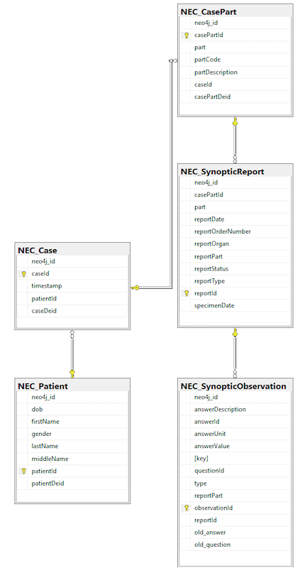
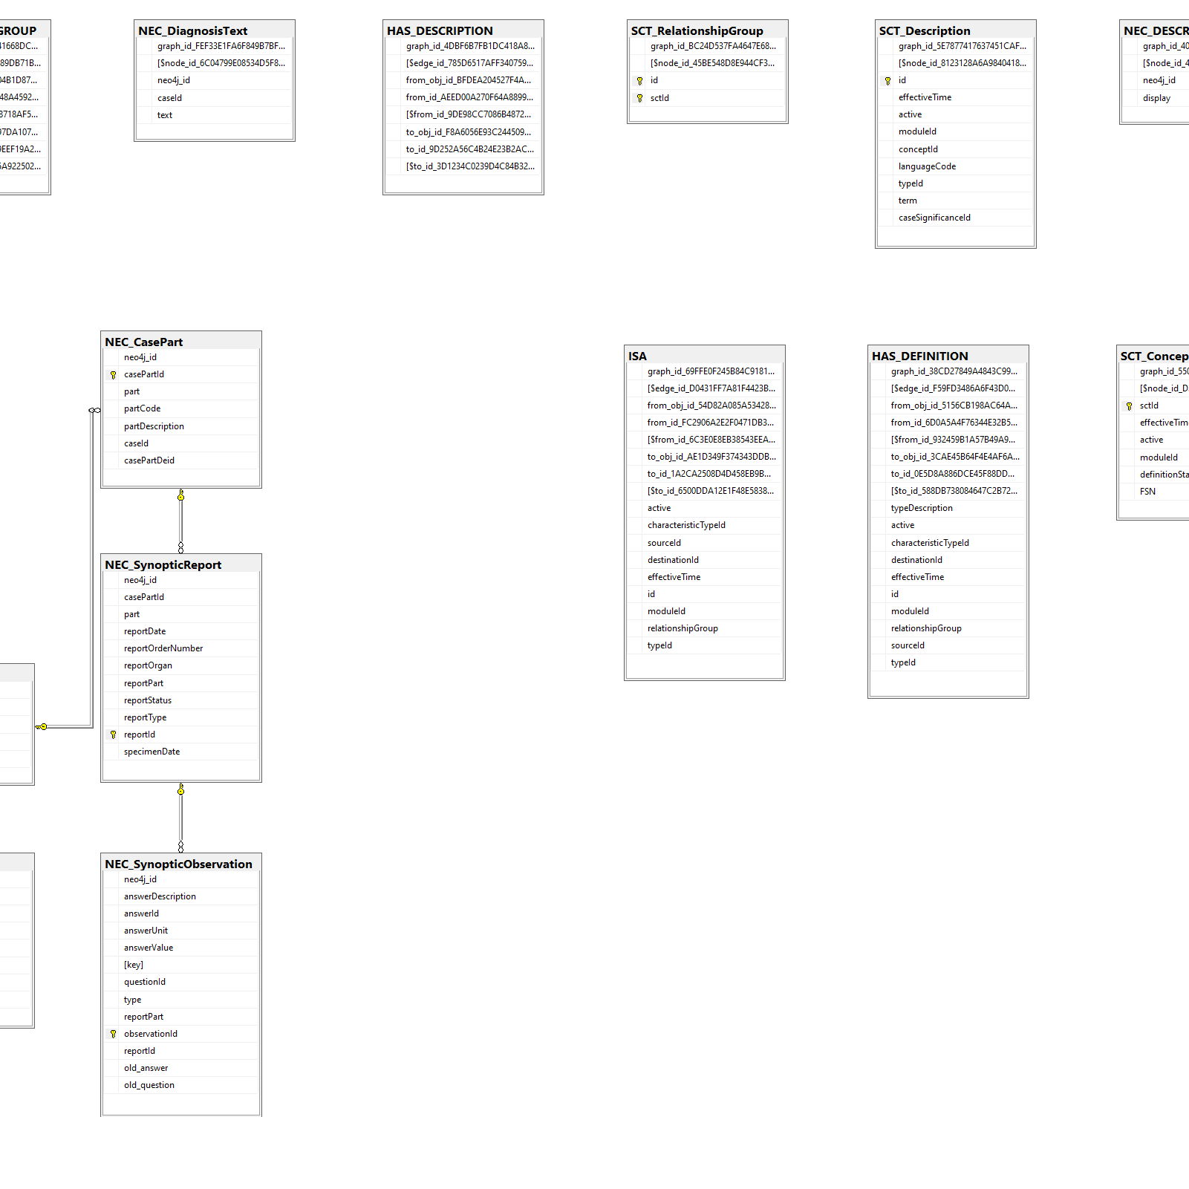
UNMC Tumor Biorepository Model
Graph allows for ECL-like query capability in runtime environment
SNOMED CT contained in MS SQL graph model
Synoptic Observations stored in RDBMS MS SQL structure
SCTID bound to graph
RDBMS allows easy to understand patient, report-level data

Slide 18
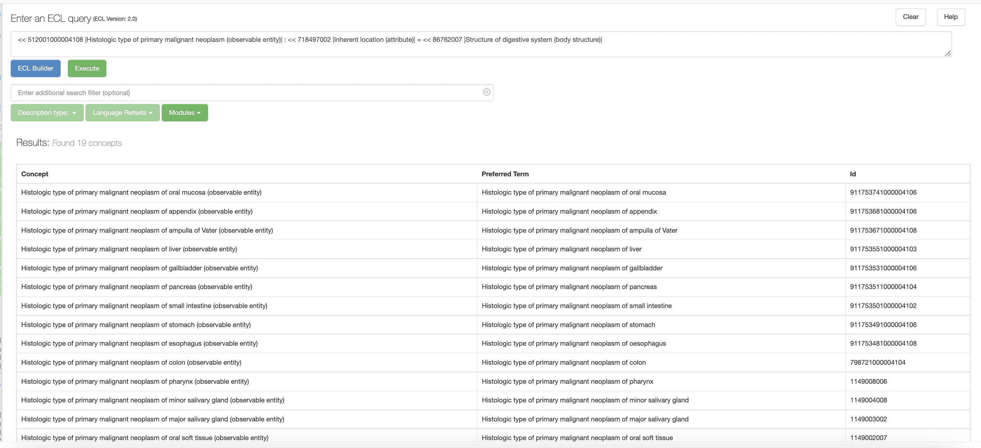
Why we care – Utility of Description Logic
All histologic types of malignant neoplasms of digestive system
Returns 19 concepts from oral cavity to anus

Slide 19
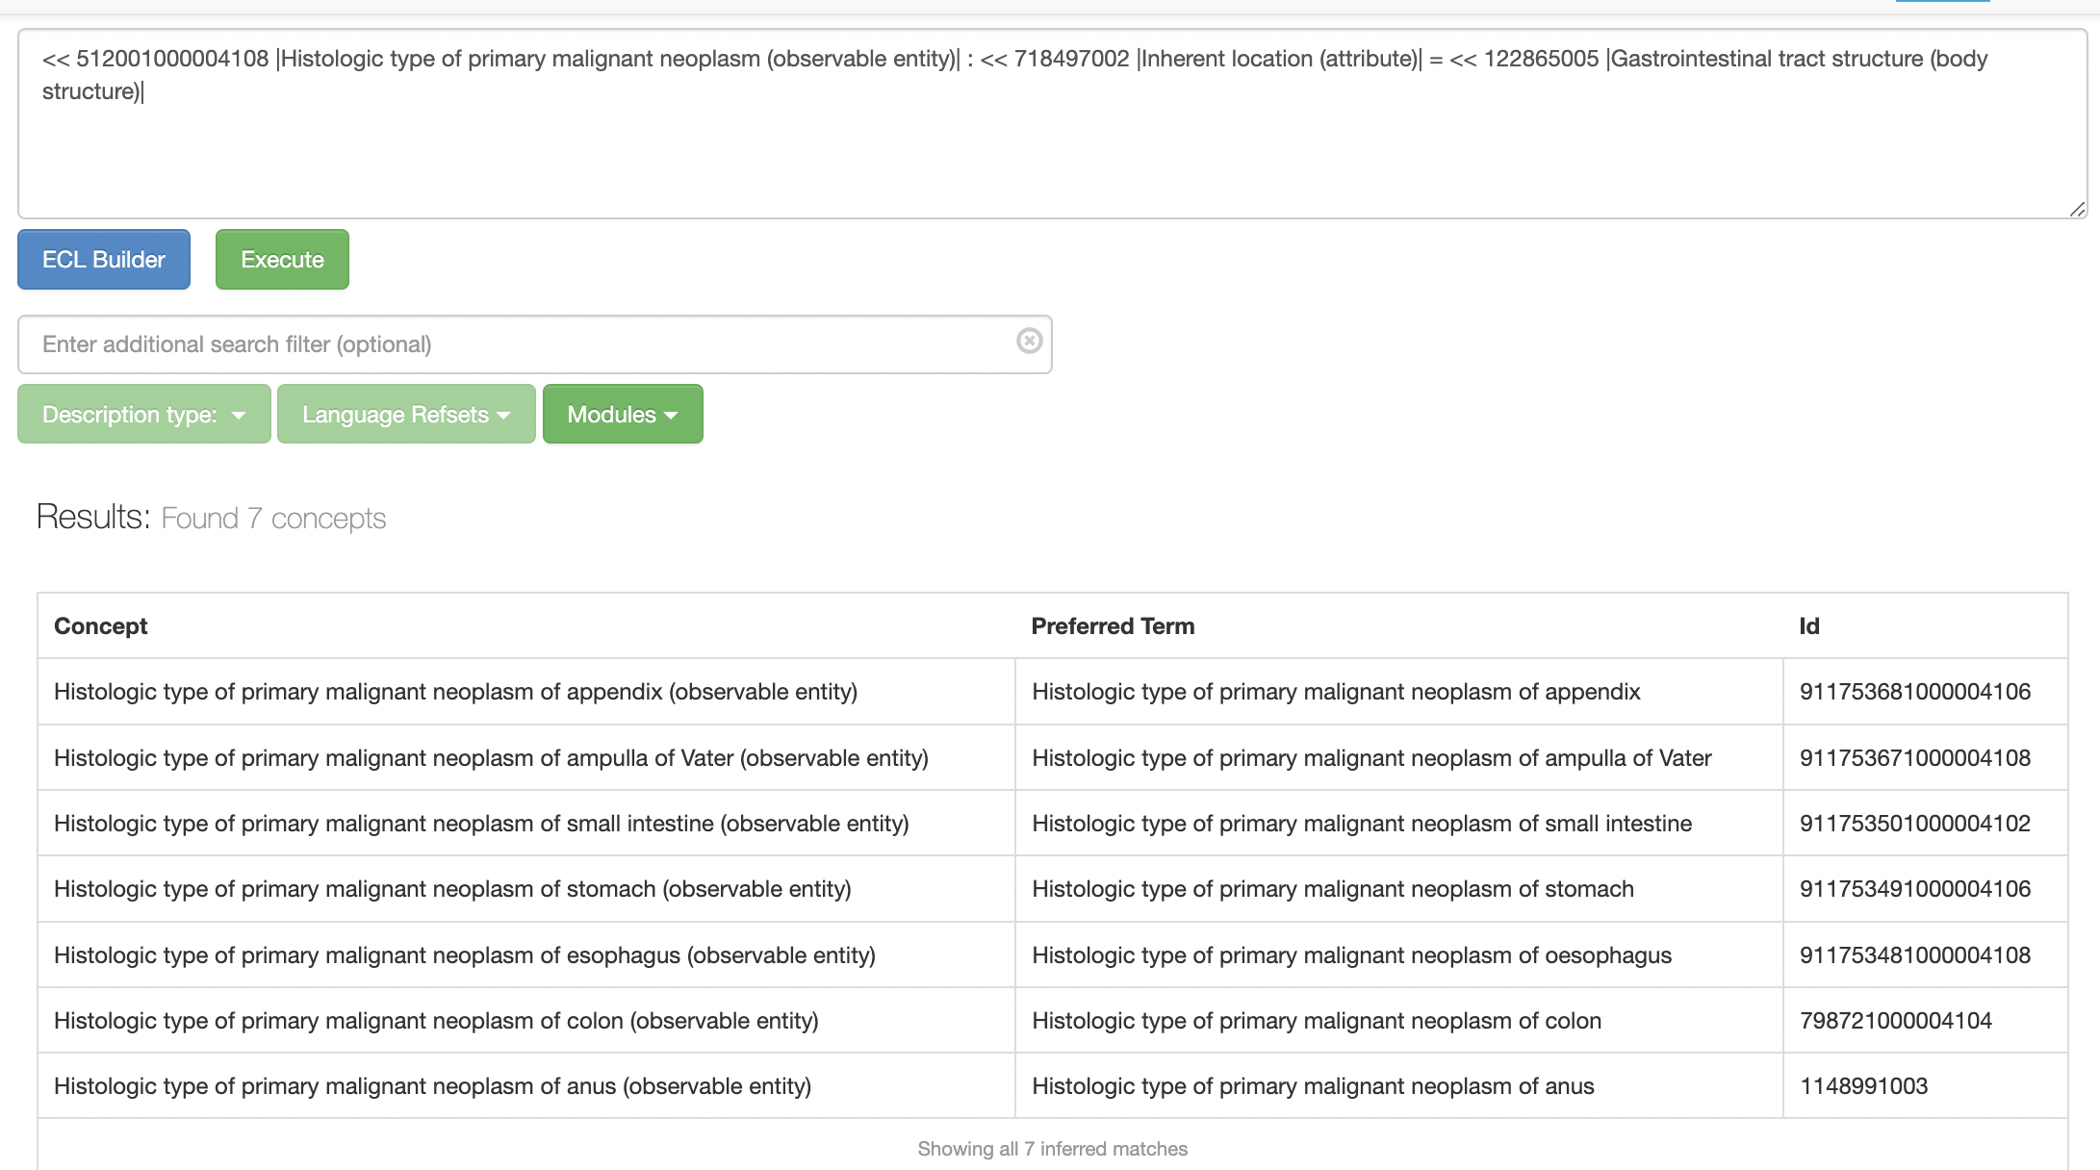
Logical queries/Clinical Decision Support
Refinement by attribute-value pairs based on logical inference
GI tract => 7 concepts

Slide 20
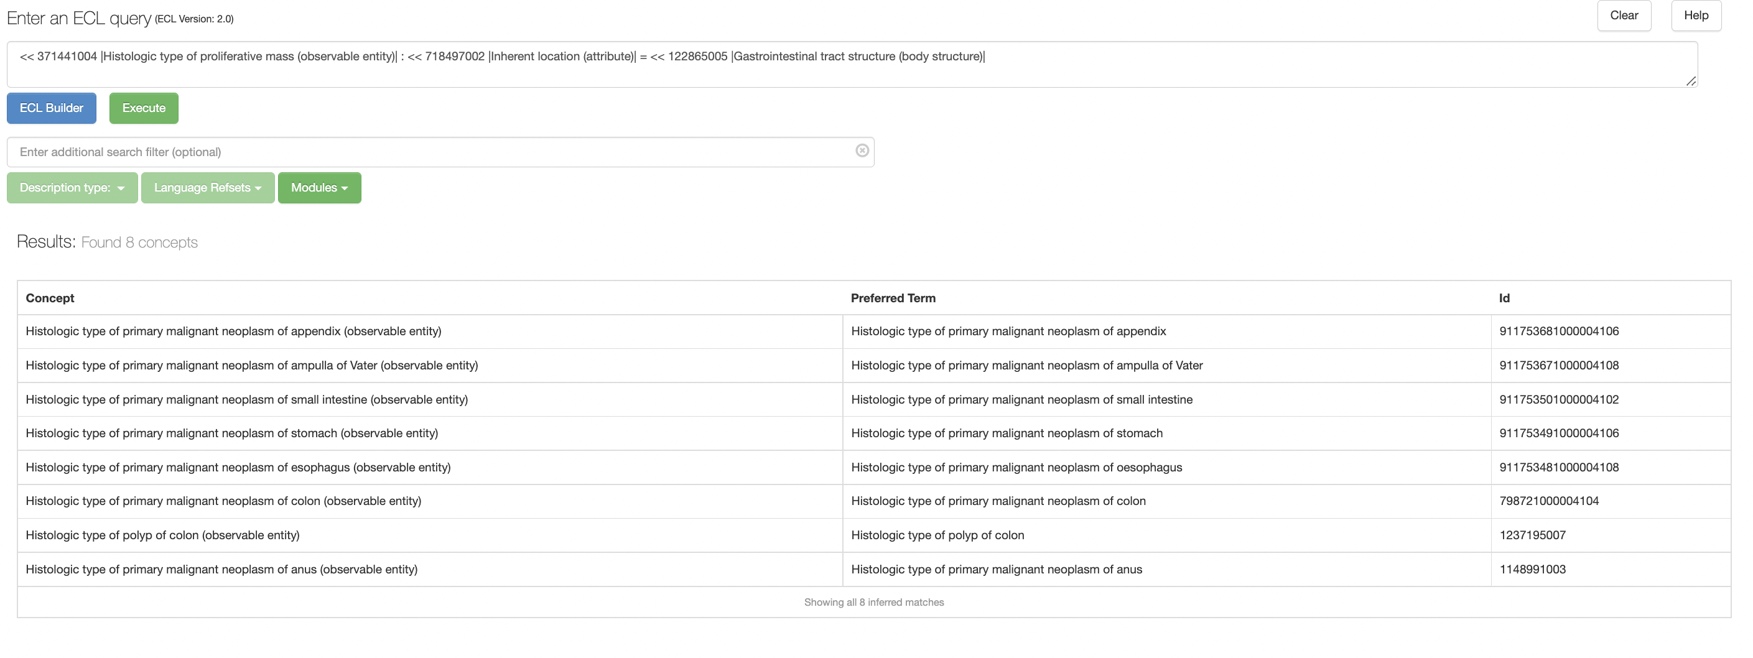
Logical inference along multiple axes
Logical queries done on multiple axes
Neoplasm vs. Malignant Neoplasm &
GI tract vs. Digestive System

Slide 21


Questions?
Global terminology enabling quality information exchange
wcampbel@unmc.edu

